Slide 1
Presentation Topic:
Computer Networking
Sadman Shafin
ID:20183001010

Slide 2
IT Center Networking Design:
  This is a Networking design of a IT Center.
  Here we will connect 7 computer & 7 laptop using a
  Router, 2 hub,4 switch,2 repeater, and 2 DHCP server in sector 1 & sector 2.
  This slide I will try to explain the full networking procedure.

Slide 3
Firstly, Let’s take a view (what do they do?) of the objectives that I’m going to use in this networking system:
Router: A router helps you connect multiple devices to the Internet, and connect the devices to each other.
Hub: A hub, also called a network hub, is a common connection point for devices in a network. Hubs are devices commonly used to connect segments of a LAN.

Slide 4
Switch: Switches manage the flow of data across a network by transmitting a received network packet only to the one or more devices for which the packet is intended.
Repeater: In telecommunications, a repeater is an electronic device that receives a signal and retransmits it.
DHCP Server: A DHCP Server is a network server that automatically provides and assigns IP addresses. Straight-through

Slide 5
Repeater: In telecommunications, a repeater is an electronic device that receives a signal and retransmits it.
DHCP Server: A DHCP Server is a network server that automatically provides and assigns IP addresses. Straight-through.
.

Slide 6
wire: A straight-through cable is a type of twisted pair cable that is used in local area networks to connect a computer to a network hub such as a router. This type of cable is also sometimes called a patch cable.
Cross-over wire: An Ethernet crossover cable is a crossover cable for Ethernet used to connect computing devices together directly.

Slide 7
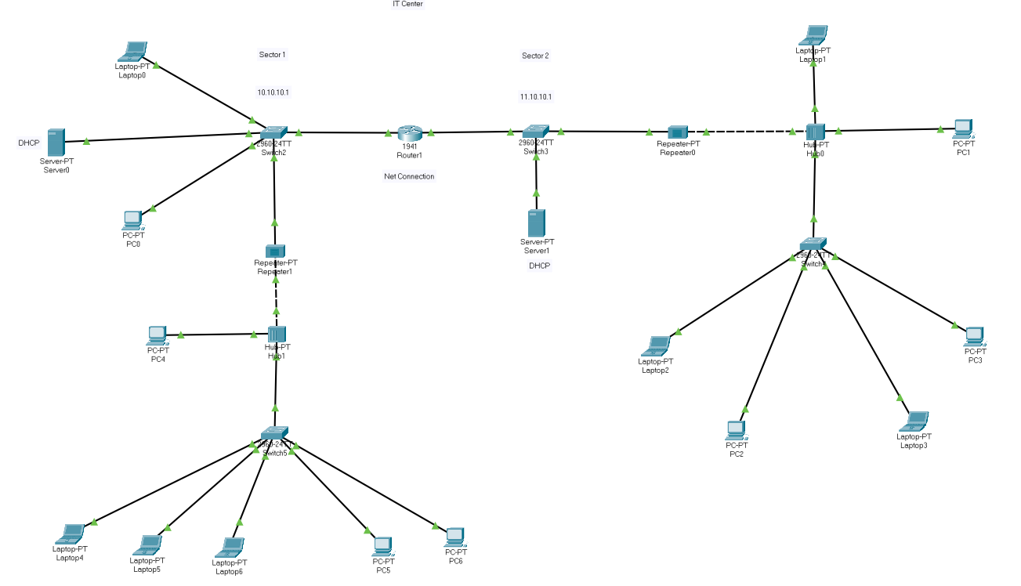
Networking Design:

Slide 8
Working Procedure:
Firstly, I used a Router (main connector) and connected 2 LAN network with it using Straight-Through wire.
The LAN Network is Sector-1 & The 2nd 1 is Sector-2.
1st Sector:
I connected The 1st Switch with the router.
Then I connected 1 DHCP server, 1 Laptop,1 Computer & 1st Repeater.
Then I connected The 1st Hub with the 1st Repeater.
I connected 1 Computer & 2nd Switch with the Repeater.
I connected 3 Laptop & 2 Computer with The 2nd Switch.

Slide 9
2nd Sector:
I connected 3rd Switch with the router.
Then I connected The 2nd DHCP Server , 2nd Repeater With the 3rd Switch .
Then I connected The 2nd Hub with the 2nd Repeater.
After that I connected 1 Laptop, 1 Computer & The Last Switch with the 2nd Hub.
Lastly I connected 2 Computer, 2 Laptop with the last switch.

Slide 10
[ 1. In every Connection I used The Straight-Through wire Except Between The Hub & Repeater.
2. Between The Hub & Repeater I used the Cross-over wire.]

Slide 11
Thank You

